Slide 1
Predictive Analytics Project
Proudly Presented By
Sam, Bo Yu, Tristan and Mark

Slide 2
Contents
Main Objective
Business-Objectives (Finance, Manpower, Prevention and Accessibility)
Data Understanding and Preparation (Excel, Rapidminer or SAS VIYA)
Data Modelling (SAS VIYA)

Slide 3
Main Objective
“To improve the quality of providing healthcare services”

Slide 4
Business Objectives
1. Finance (Bo Yu)
2. Manpower (Tristan)
3. Prevention (Mark)
4. Accessibility (Sam)

Slide 5
Finance

Slide 6
Business Objectives - Finance
Profile the segment of customers that gives the highest average hospital bills
Identify factors that will affect customer cost of hospital bills
Success Criteria: To successfully help patients to reduce on their hospital bills based on the findings

Slide 7
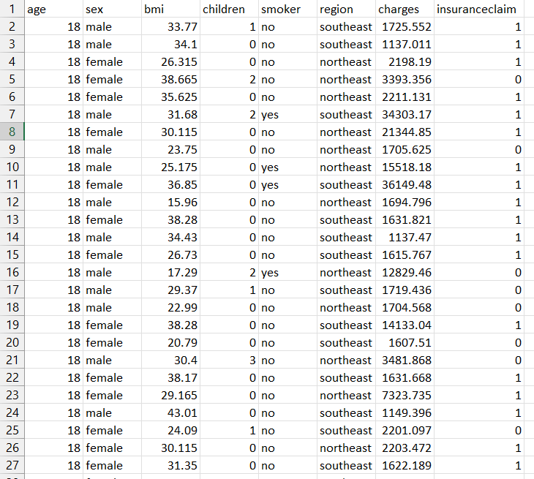
Finance Dataset
Finance
Contain the risk underwriting in Health Insurance, the interplay of various attributes of the insured and see how they affect the insurance premium.
Insurance(HealthCare) | Kaggle
age, sex (Male or Female), bmi (Body Mass Index),
children, smoker, region, charges and insurance
claim
1338 Rows of Observation

Slide 8
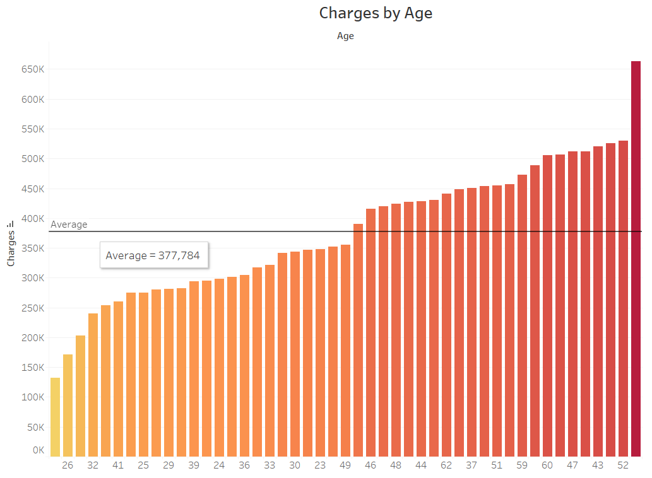
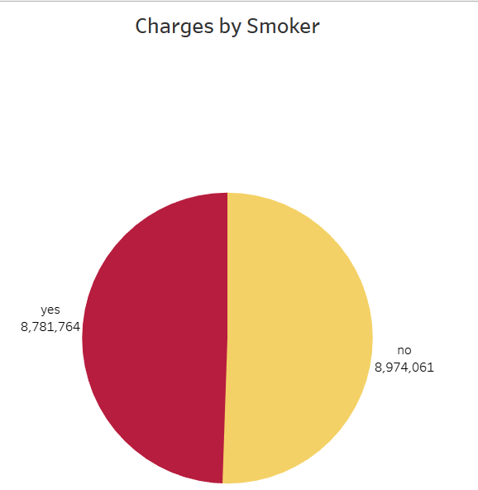
Data Understanding
Finance
Age Chart
Smoker Chart

Slide 9
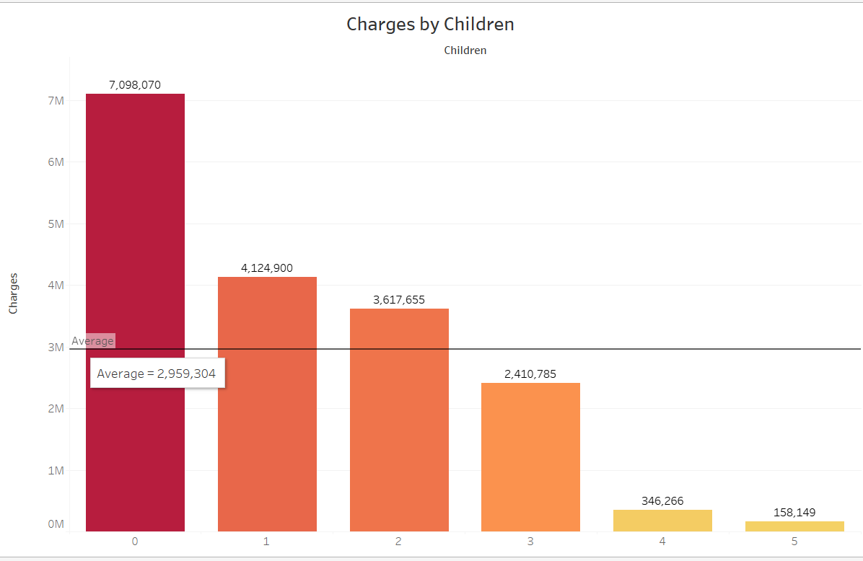
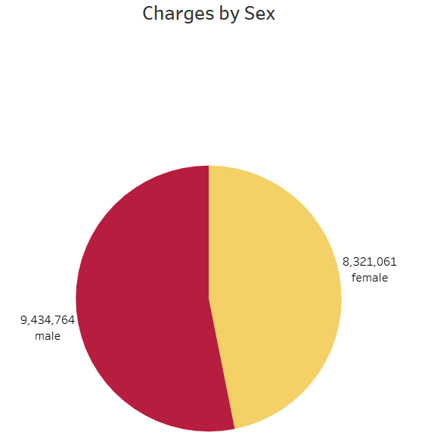
Data Understanding
Finance
Children Chart
Sex Chart

Slide 10
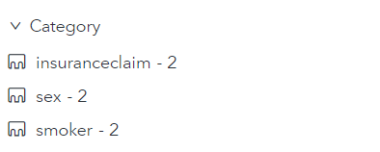
Data Preparation
Finance
Setting Inputs to Category Classification
Data Items

Slide 11
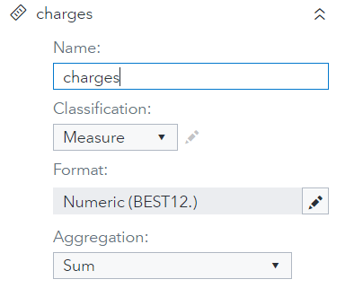
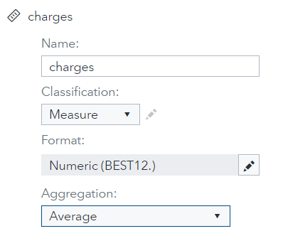
Data Preparation
Finance
Before
After

Slide 12
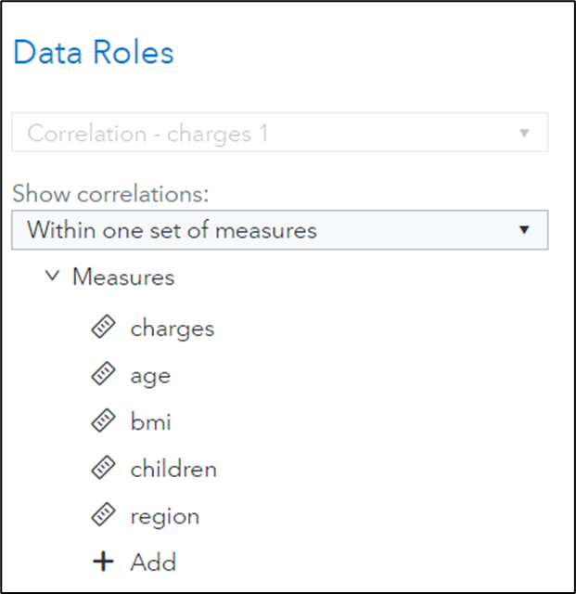
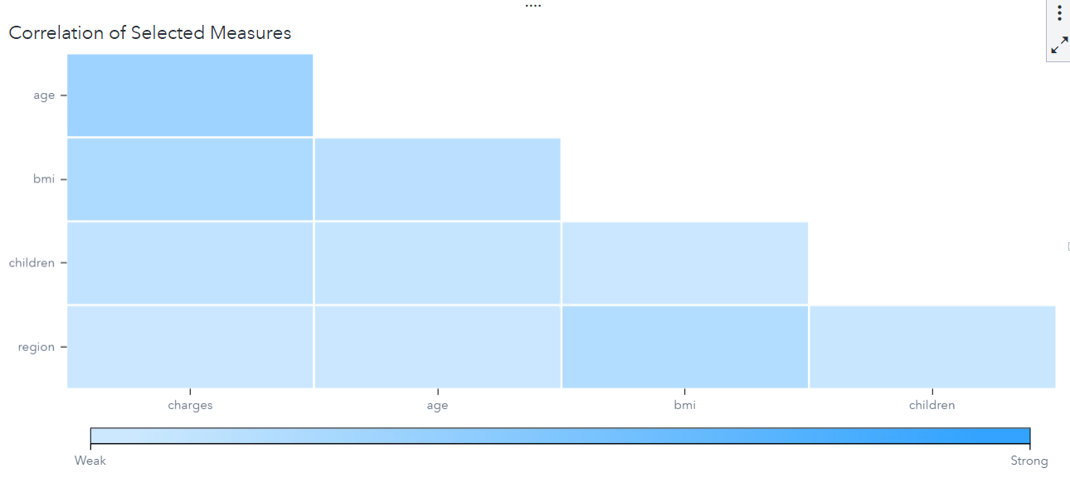
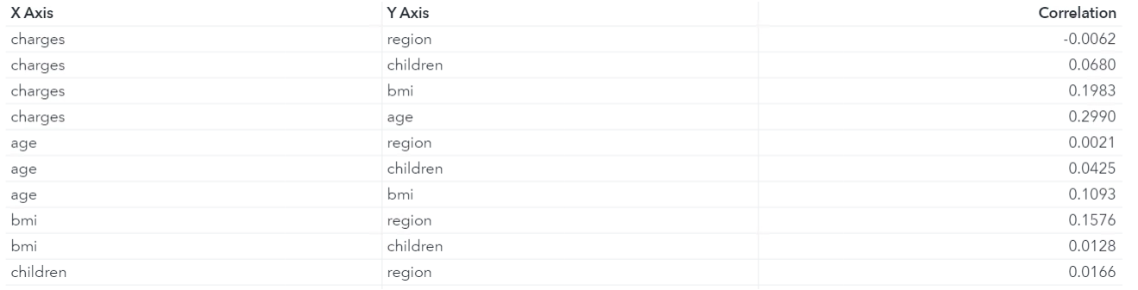
Data Modelling (Feature Selection)
Finance
Inputs
Chart
Results
Notes:
Age affect the charge (target variable)

Slide 13
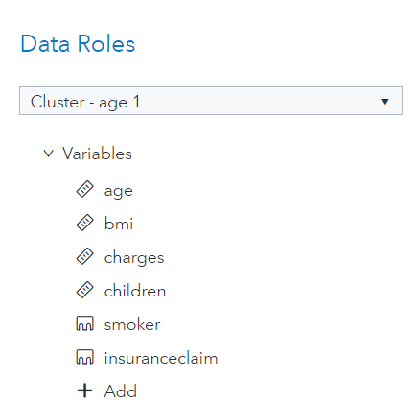
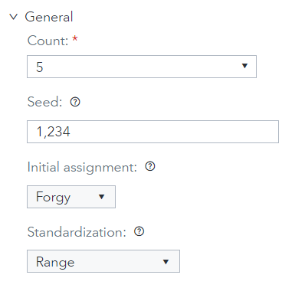
Data Modelling (Clustering)
Finance
Parameter Tuning
Number of K Cluster
Inputs

Slide 14
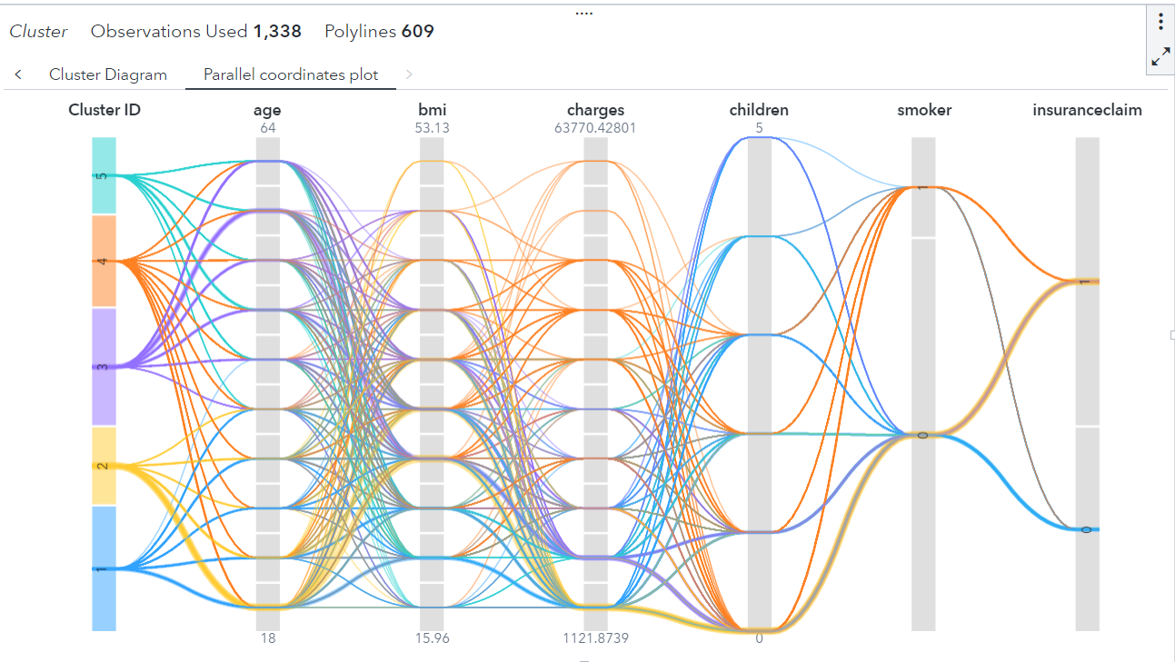
Data Modelling (Clustering)
Finance
Parameter Tuning
Results

Slide 15
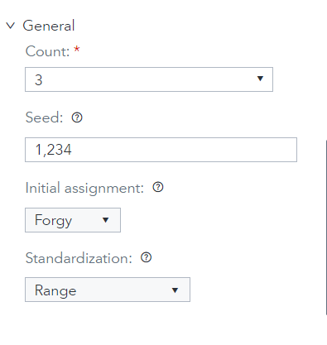
Data Modelling (Clustering)
Finance
Parameter Tuning
Number of Cluster

Slide 16
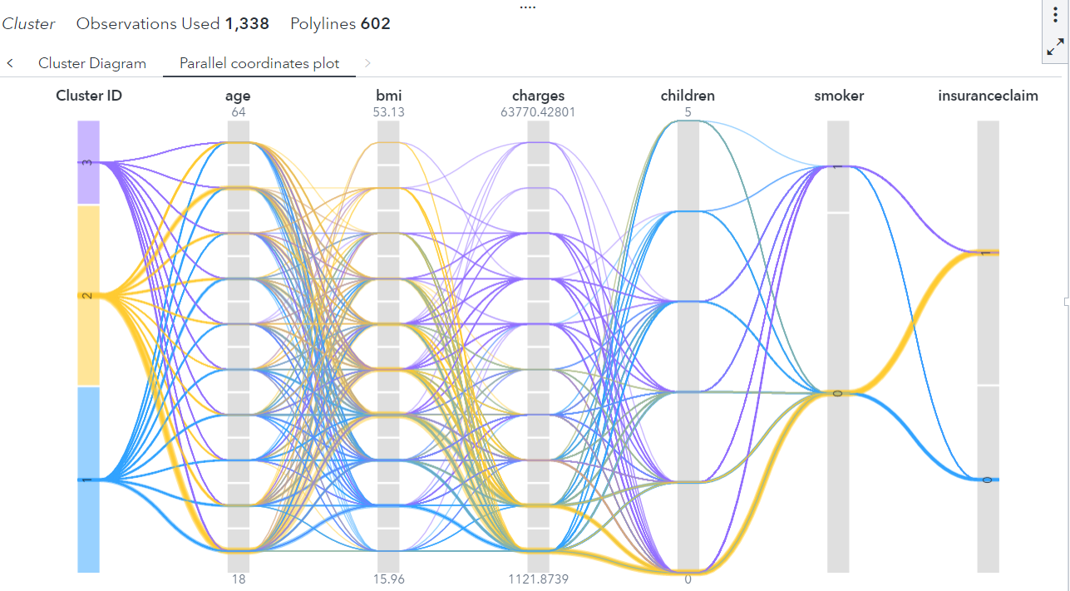
Data Modelling (Clustering)
Finance
Parameter Tuning
Results

Slide 17
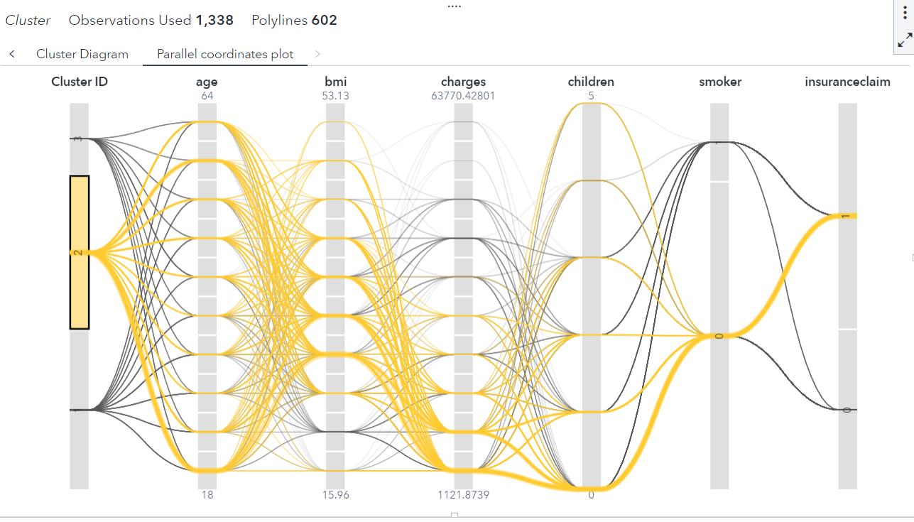
Data Modelling (Clustering)
Finance
Parallel Coordinates Plot
Results

Slide 18
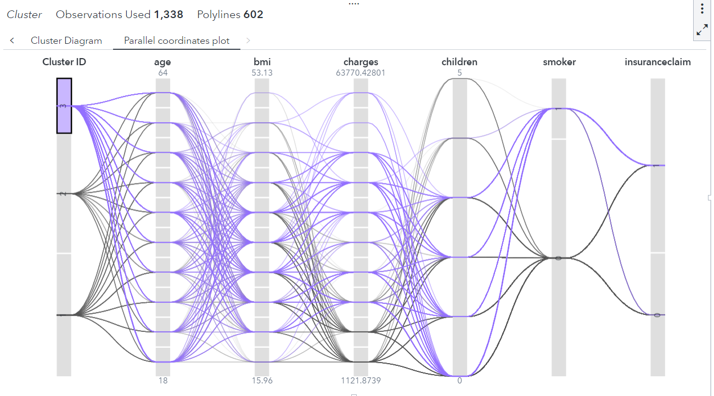
Data Modelling (Clustering)
Finance
Parallel Coordinates Plot
Results

Slide 19
Data Modelling (Clustering)
Finance
Centroids
Results

Slide 20
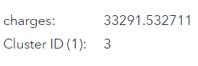
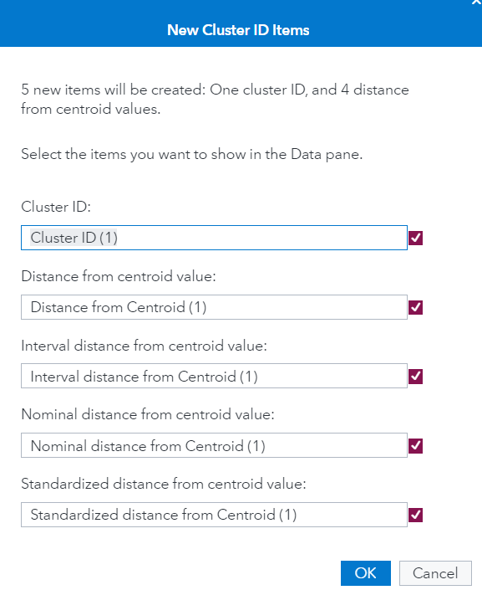
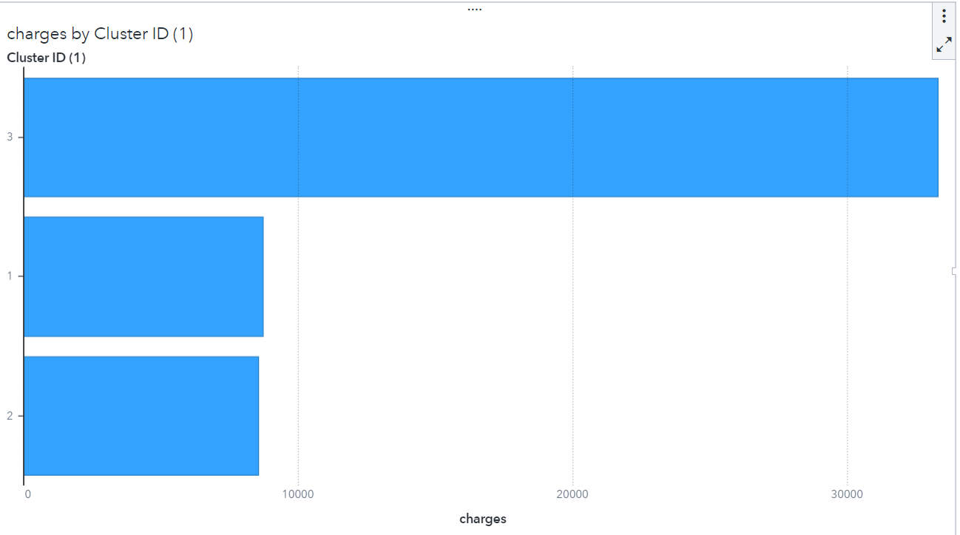
Data Modelling (Clustering)
Finance
Derive Cluster ID & Autochart
Results

Slide 21
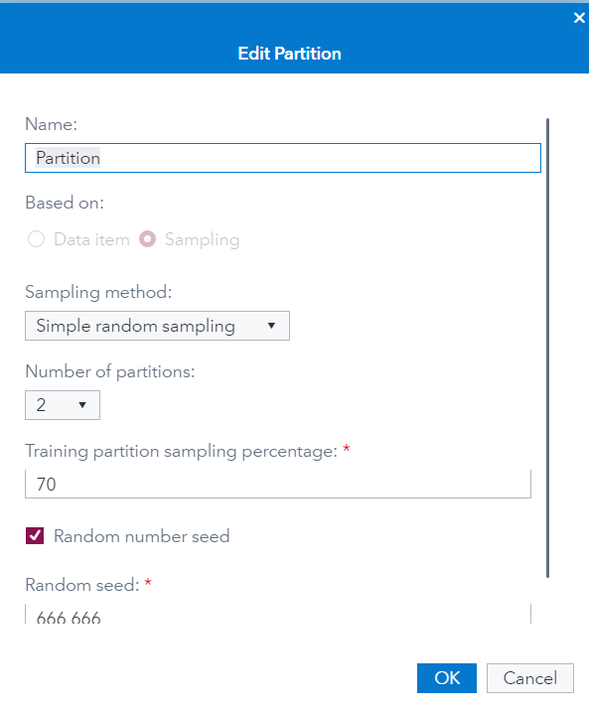
Data Modelling (Linear Regression)
Finance
Partition
Partition Options
Notes:
Partition

Slide 22
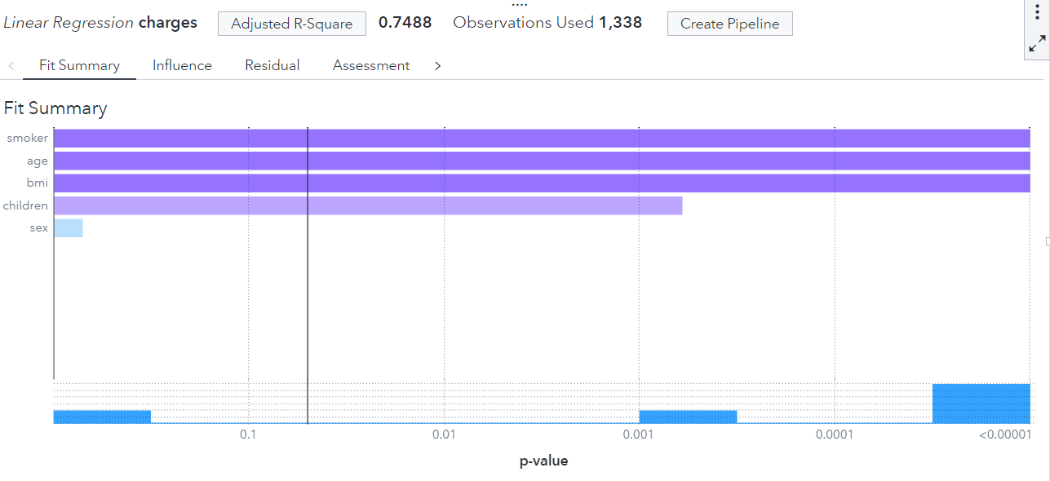
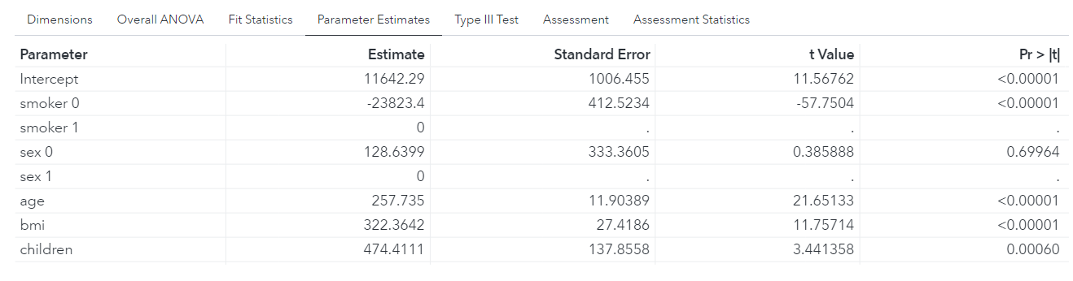
Data Modelling (Linear Regression)
Finance
Before tuning of the model
Chart
Results
Notes:
The inputs affect the insurance charges like more expensive based on the p-values <= 0.05

Slide 23
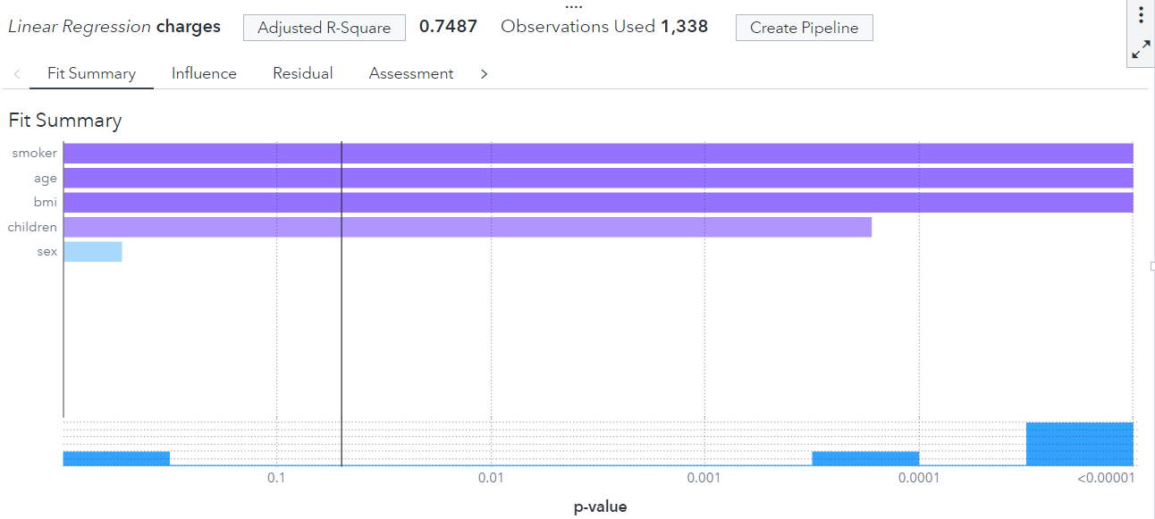
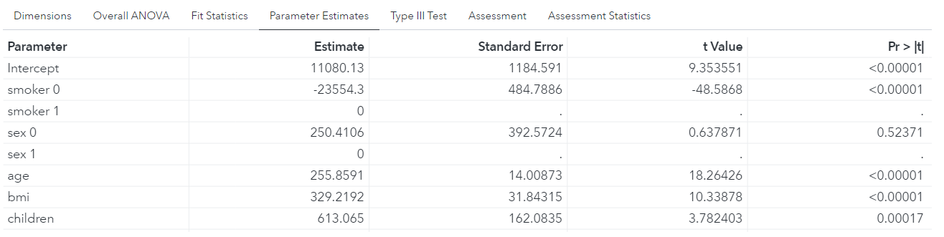
Data Modelling (Linear Regression)
Finance
After tuning of the model
Chart
Results
Notes:
The inputs affect the insurance charges like more expensive based on the p-values <= 0.05

Slide 24
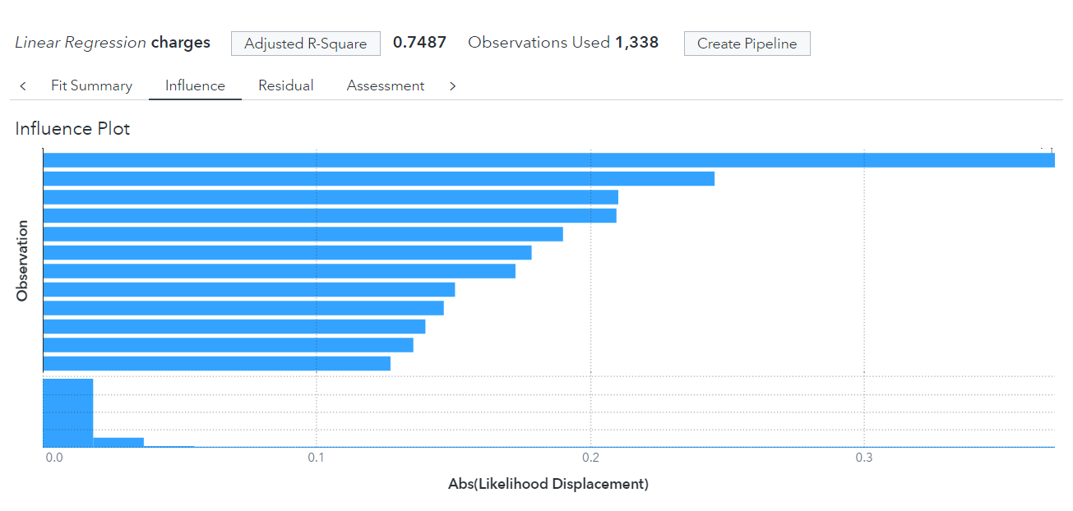
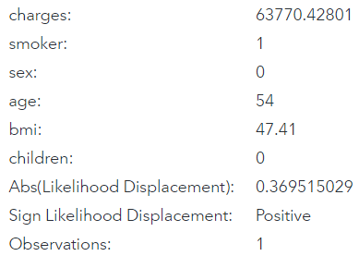
Data Modelling (Linear Regression)
Finance
Influence Plot
Chart
Notes:
This are some outliers on influence plot shown, most of the statics show that the age , outliers show that

Slide 25
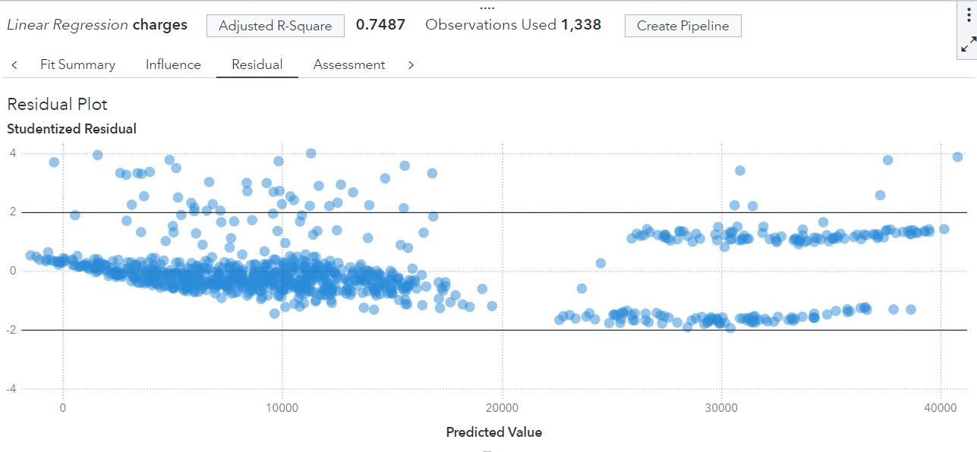
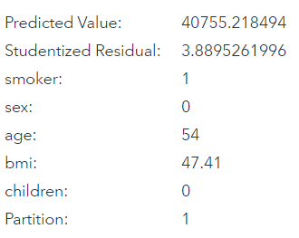
Data Modelling (Linear Regression)
Finance
Residual Plot
Chart
Notes:
This model is good as they are close to 0 but there are some outliers which need to be removed for better performance

Slide 26
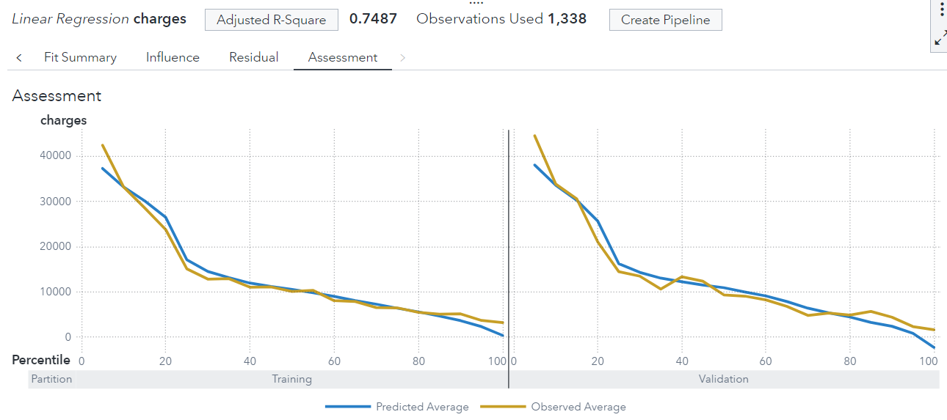
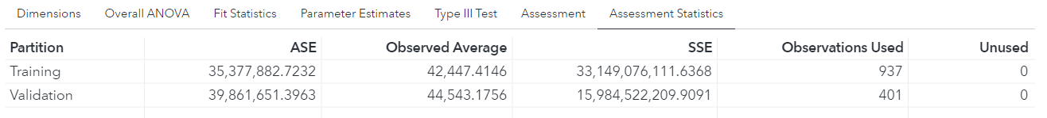
Data Modelling (Linear Regression)
Finance
Assessment Plot
Charts
Results
Notes:
The line chart (trend, observation used)

Slide 27
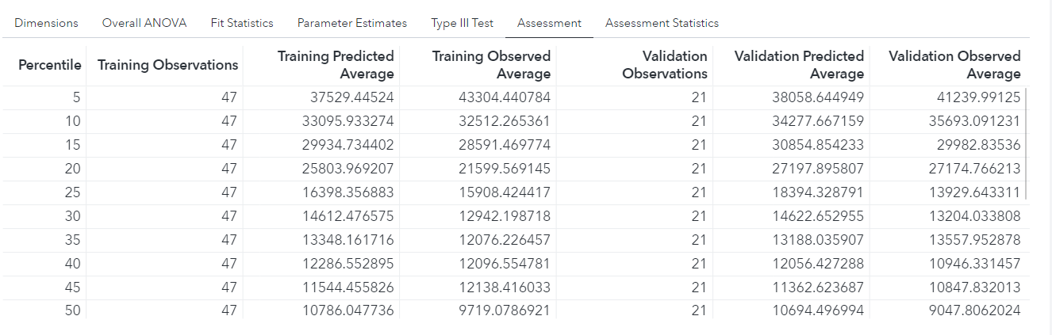
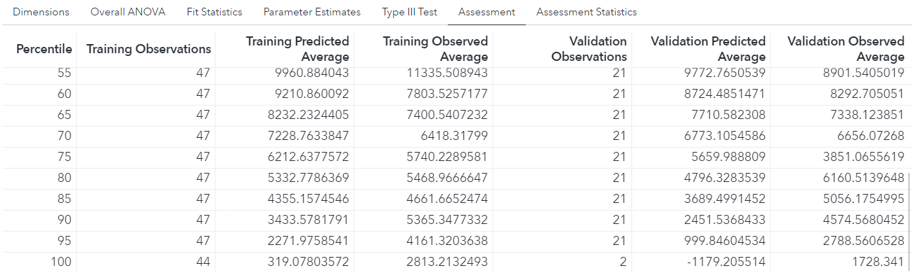
Data Modelling (Linear Regression)
Finance
Assessment
Results
Notes:
Summary/Decreasing

Slide 28
Findings
Finance
Factors/Inputs that affect the hospital bills
Age
Smoker
BMI
Children
Notes:
Customer should look at this input for hospital bills and fulfill the business objectives

Slide 29
Conclusion & Recommendations
Finance
To improve the quality of providing healthcare services:
Implement Healthcare Scheme for Aging People and Families with Childrens
Depend on Patients for Smoker and BMI
Notes:
Recommendation

Slide 30
Manpower

Slide 31
Business Objectives - Manpower
Identify factors that influence the ratio of nurses to population, and aim to optimize this ratio
Identify factors related to manpower that affect the ratio of serious/critical cases the most
Aim to reduce the ratio of critical cases while maintaining a low manpower to population rate

Slide 32
Data Collection
Manpower
Objective -find examples of good COVID-19 management with a reasonable manpower count
I decided to use 1 dataset for this study (2 datasets merged into one).
The merged dataset contained information about COVID-19 stats, healthcare expenditures and staff counts.
Used to analyze which countries have sufficient manpower or testing ratios which let them handle the situation well.

Slide 33
Data Collection
Manpower
The first dataset contains all numerical variables, notable examples being population, deaths, cases, and the ratio of serious to all active cases. The merged table contains various expenditure figures, nurse/midwife, surgeon and physician to population ratio. (After cleaning it had 108 rows, which I duplicated 1000 times)

Slide 34
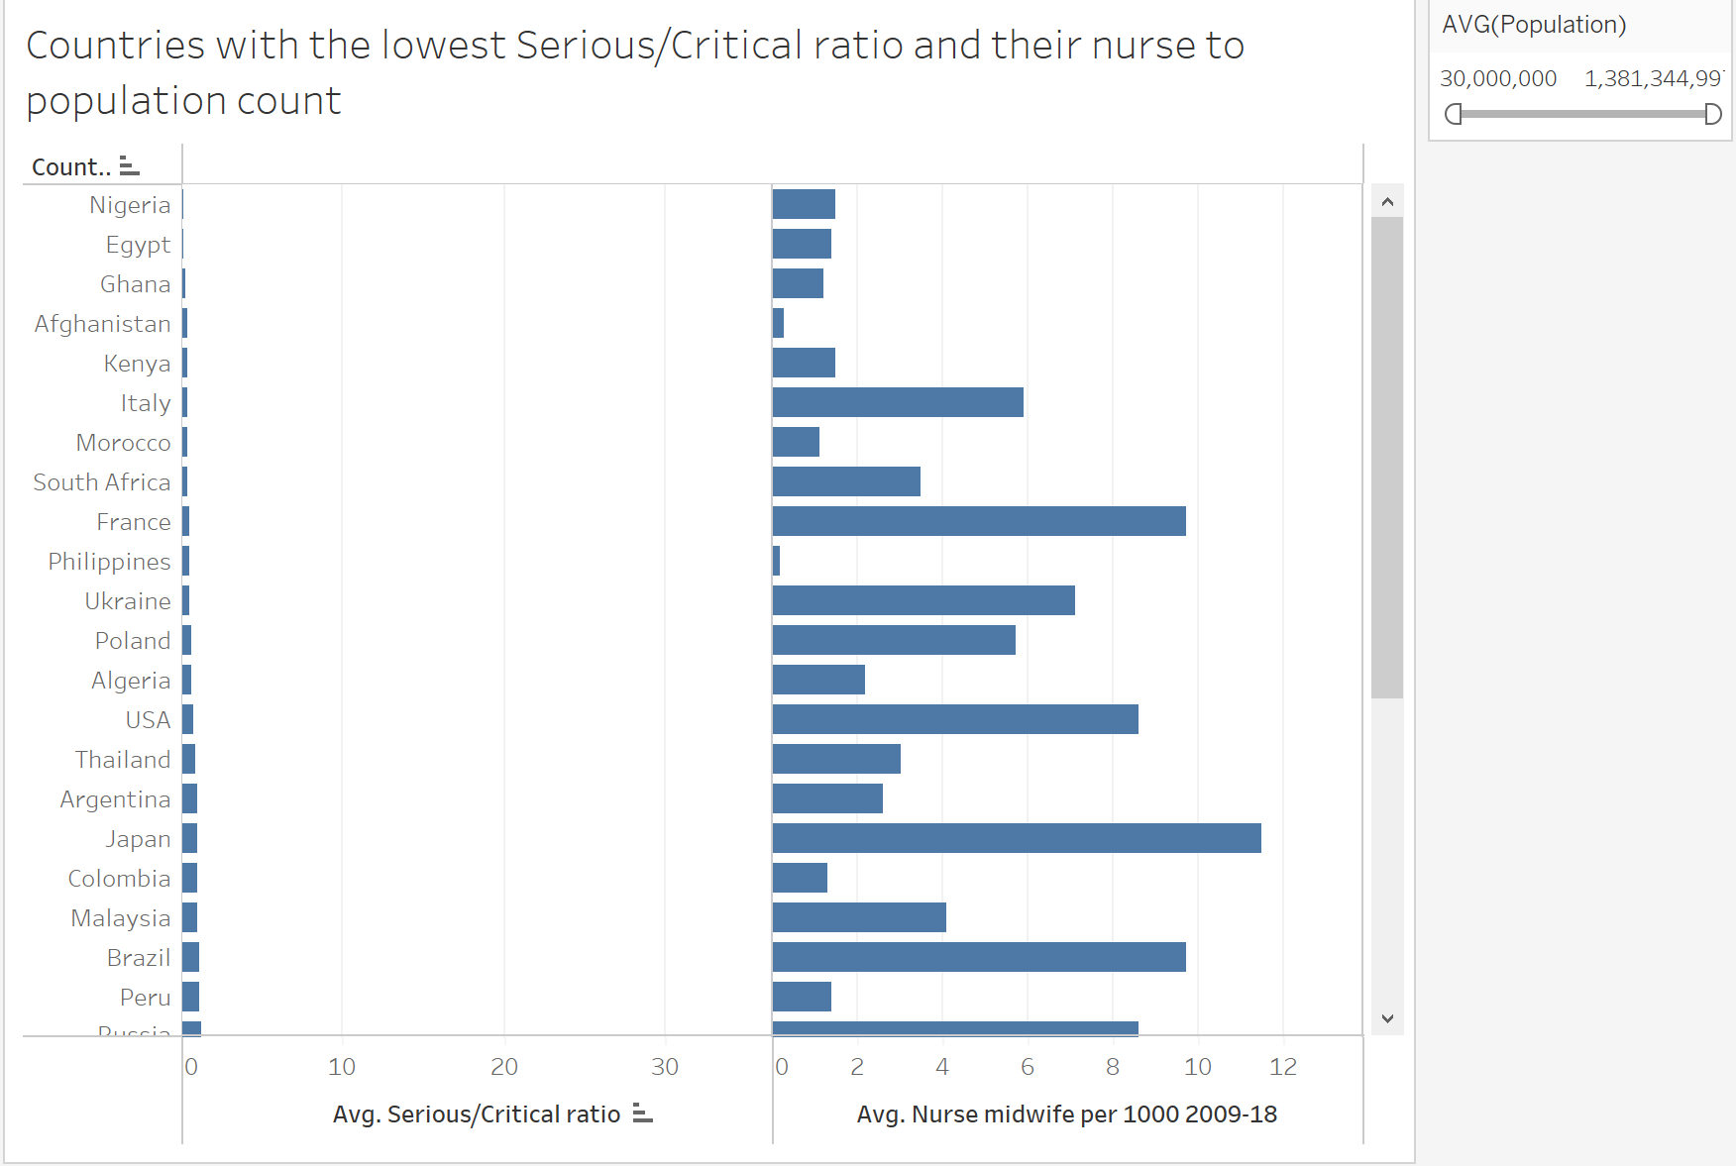
Data Understanding
Manpower

Slide 35
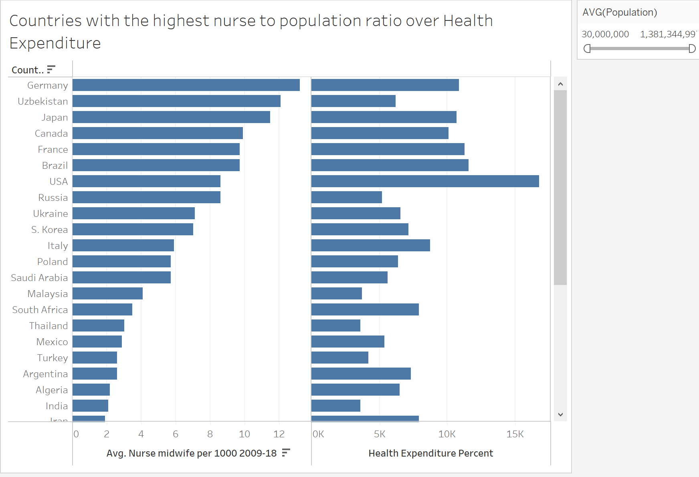
Data Understanding
Manpower

Slide 36
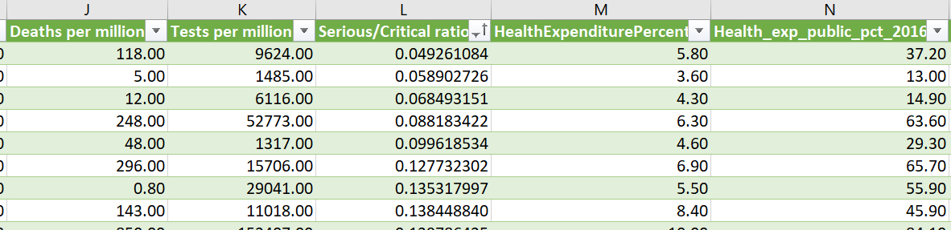
Data Preparation
Manpower
Merged two datasets to compare COVID data against manpower levels.
Table 1
Table 2
Made a column comparing the number of serious cases to deaths for analysis.
Also removed rows with more than 50% of the columns having null values.

Slide 37
Data Preparation
Manpower
Changing data type in SAS
-Some categorical variables were registered as numerical variables and vice versa
Excel values with hidden errors
-There were columns with numerical values registering as text, then displaying as null in Tableau, which rendered it unusable in analysis. Manual input was required to fix the error, which could be attributed to a hidden bugged character

Slide 38
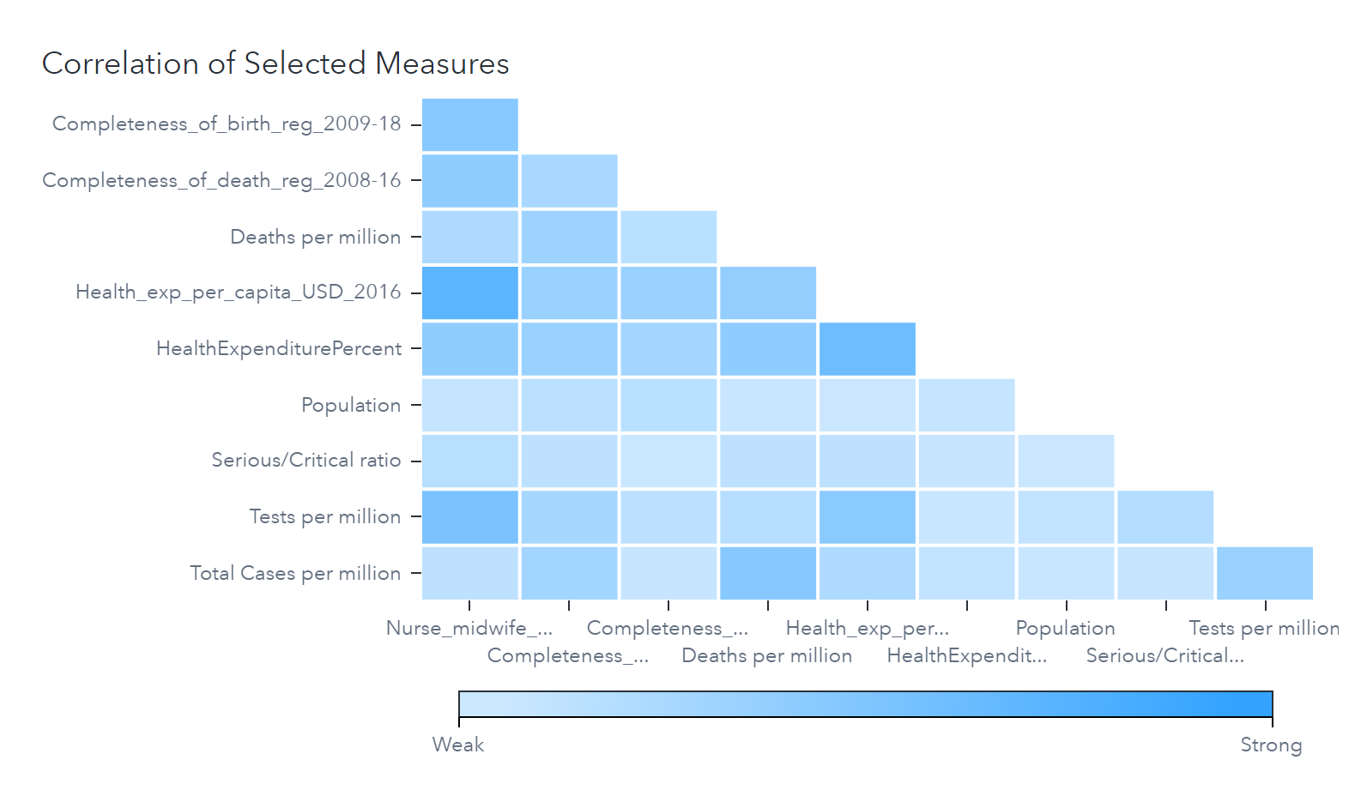
Feature Selection - Manpower
Manpower

Slide 39
Feature Selection - Manpower
Manpower
Target variable used was the ratio of Nurses to population (1000 people)
Notable insights from feature selection:
Target variable, nurses per 1000 people was largely influenced by or had influenced:
Health expenditure per capita (0.7293 correlation)
COVID 19 tests per million (0.5268 correlation)
Other correlated factors:
Total cases per million and deaths per million
Tests per million and healthcare expenditure per capita

Slide 40
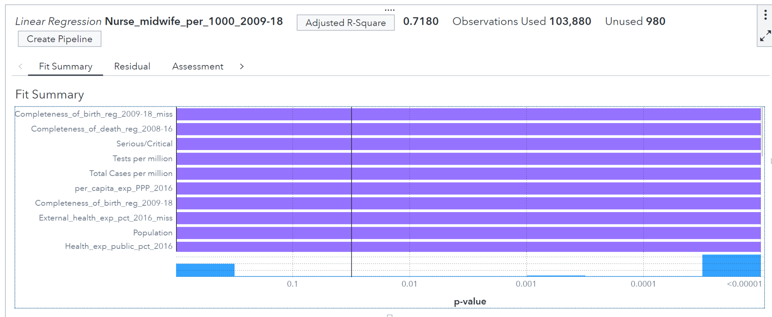
Linear Regression
Manpower

Slide 41
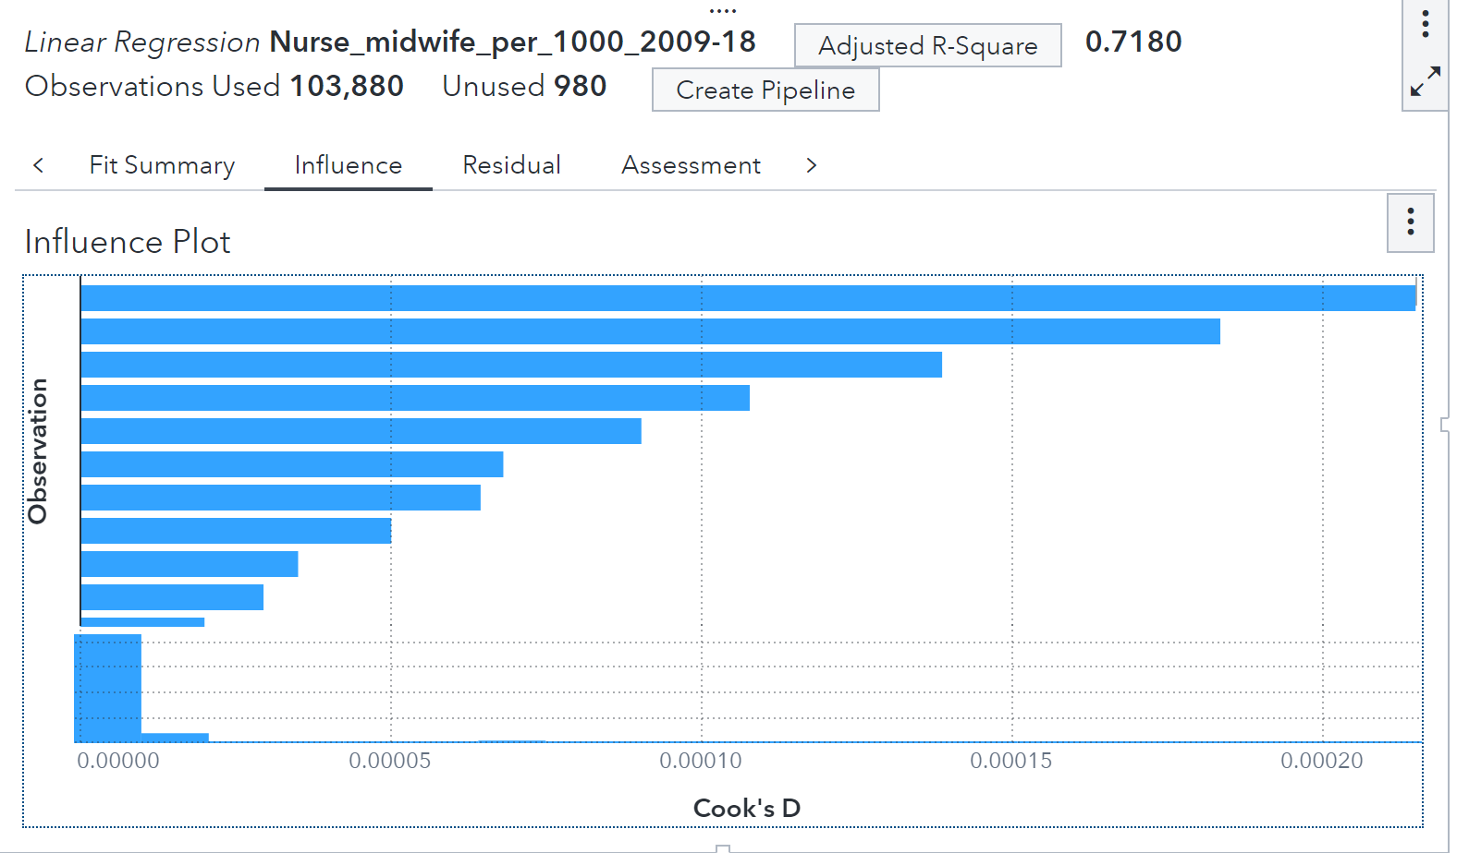
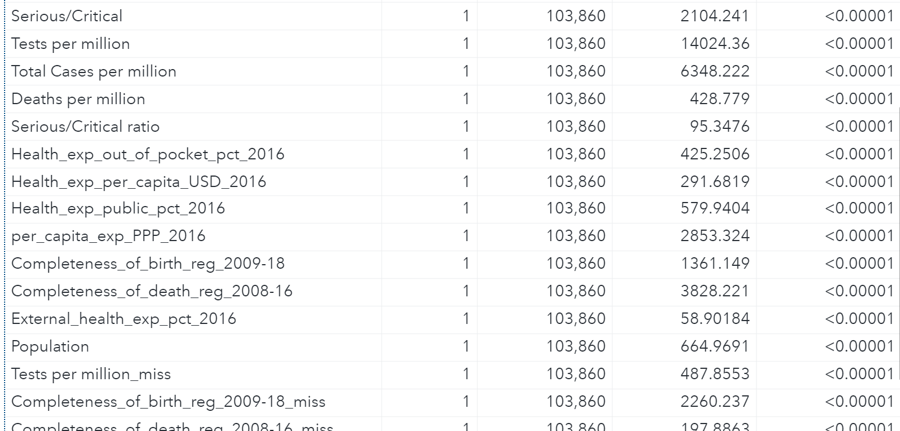
Linear Regression
Manpower

Slide 42
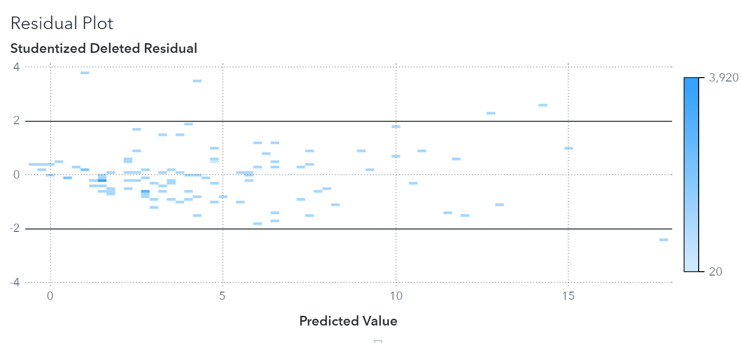
Linear Regression
Manpower

Slide 43
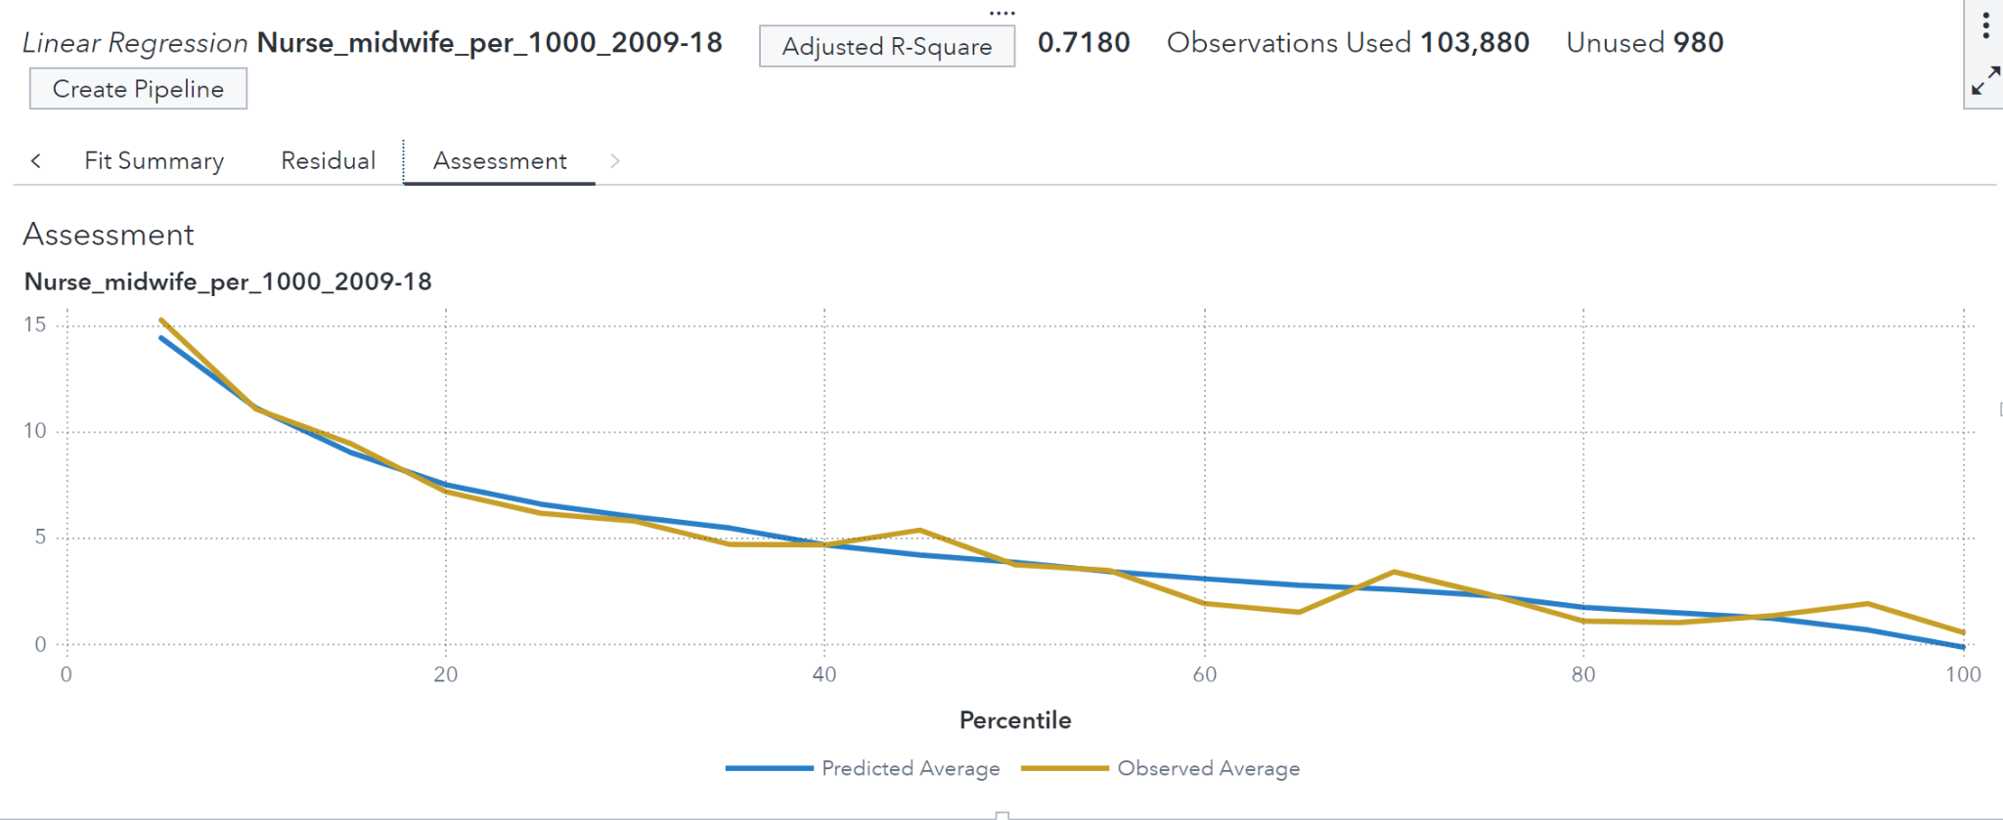
Linear Regression
Manpower

Slide 44
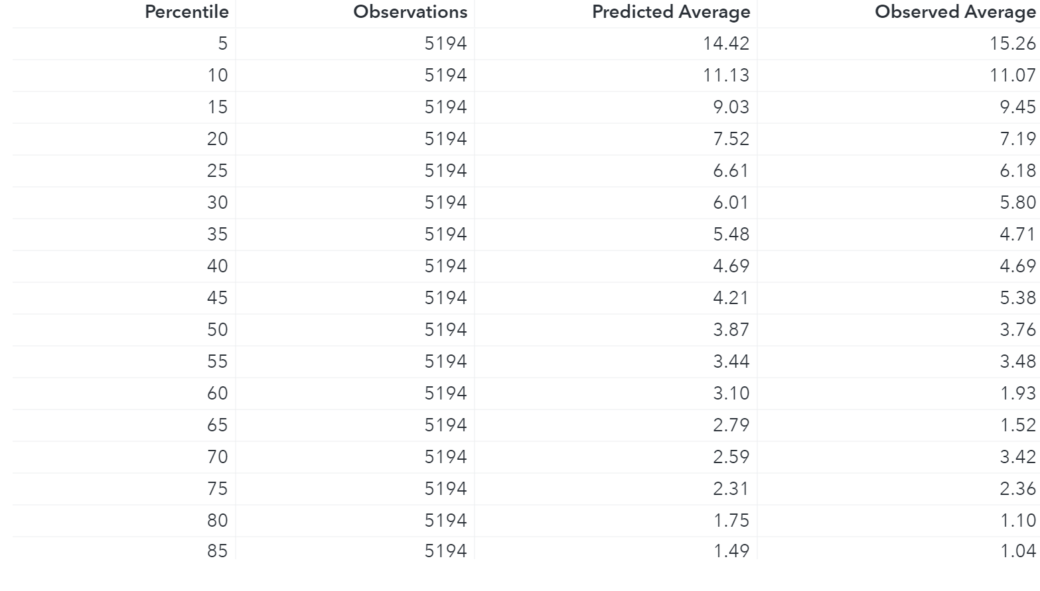
Linear Regression
Manpower

Slide 45
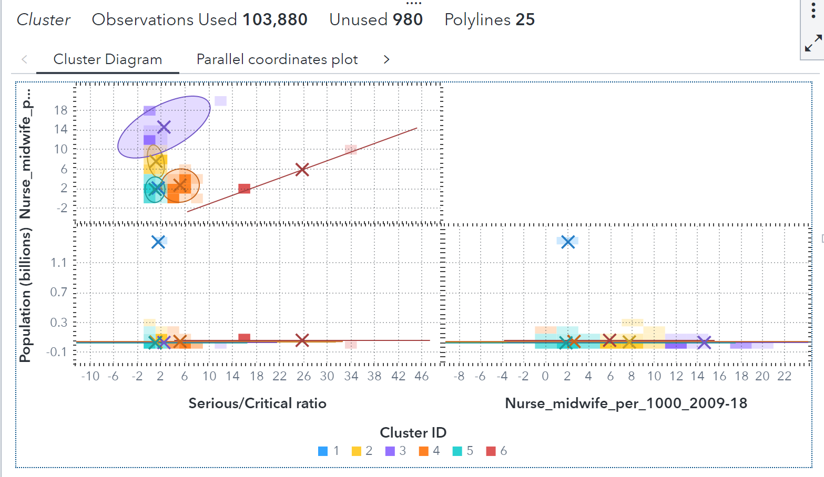
Clustering
Manpower

Slide 46
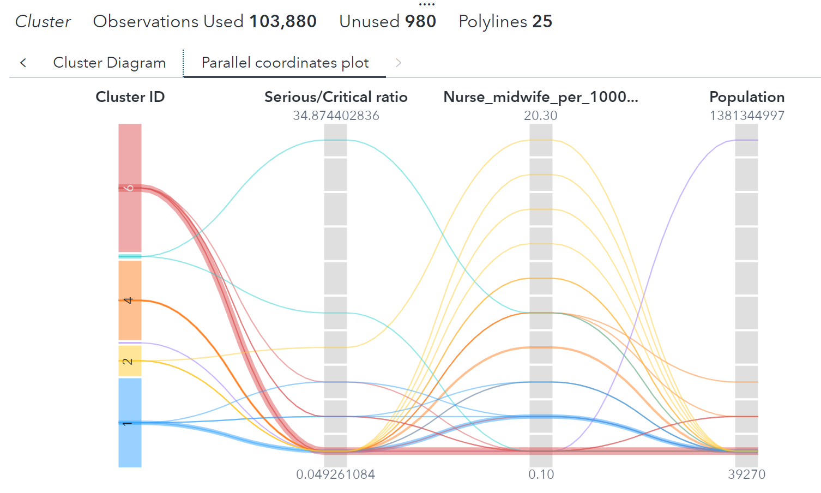
Clustering
Manpower

Slide 47
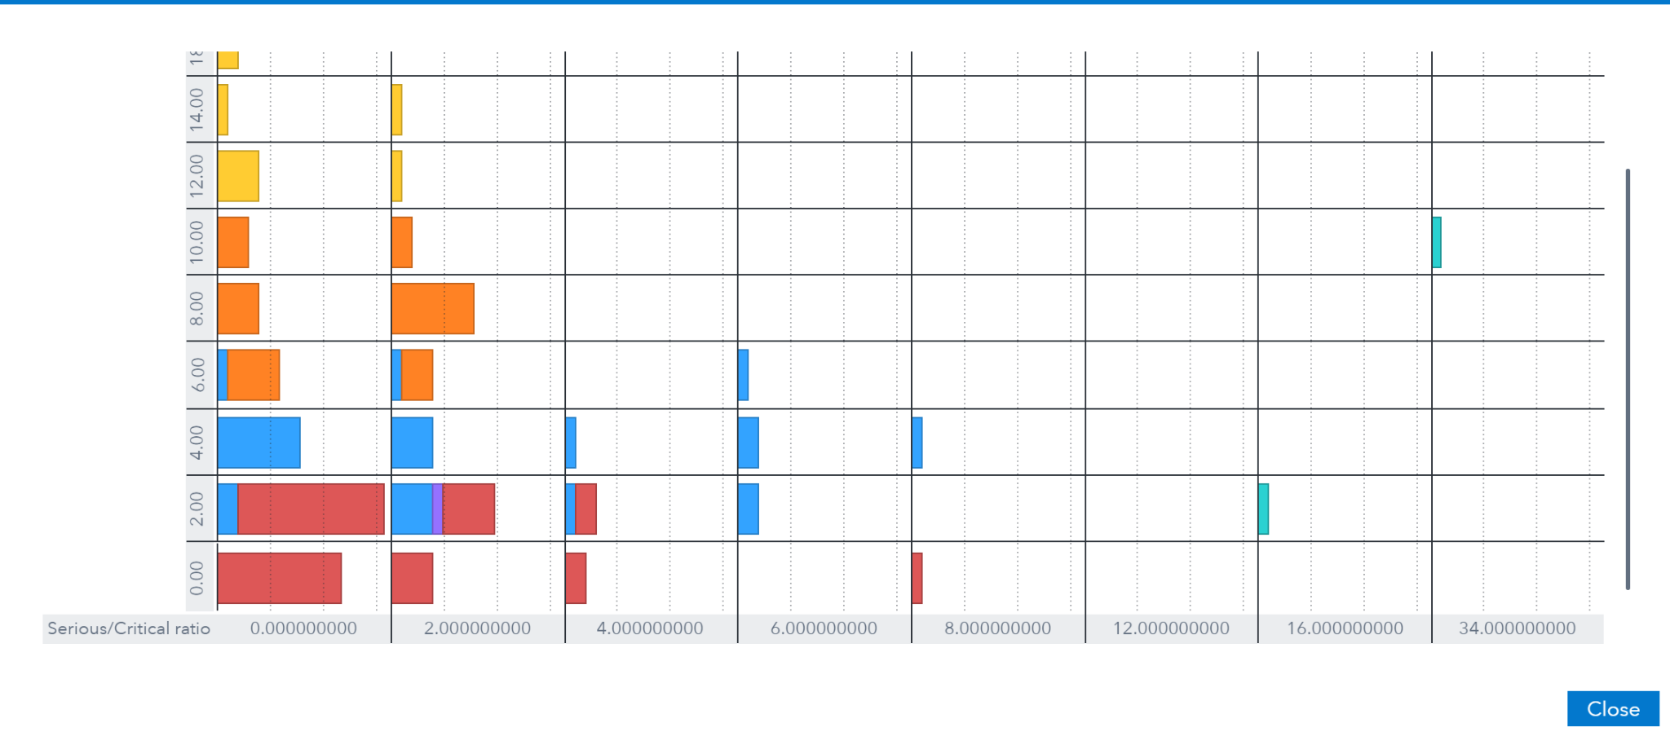

Clustering
Manpower

Slide 48
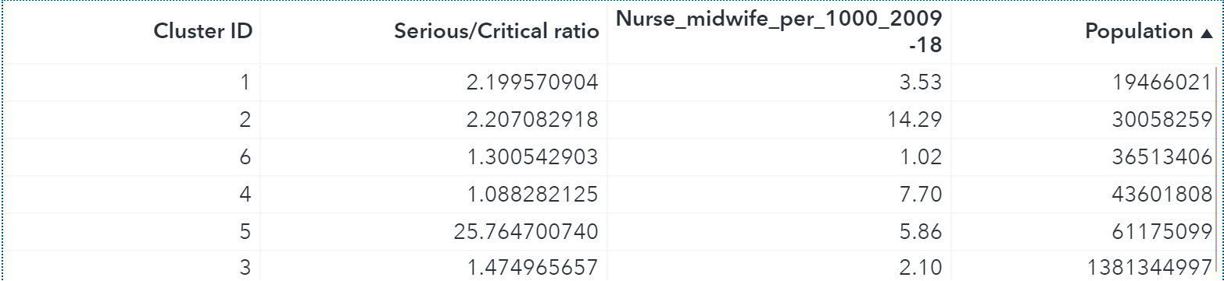
Clustering
Manpower

Slide 49
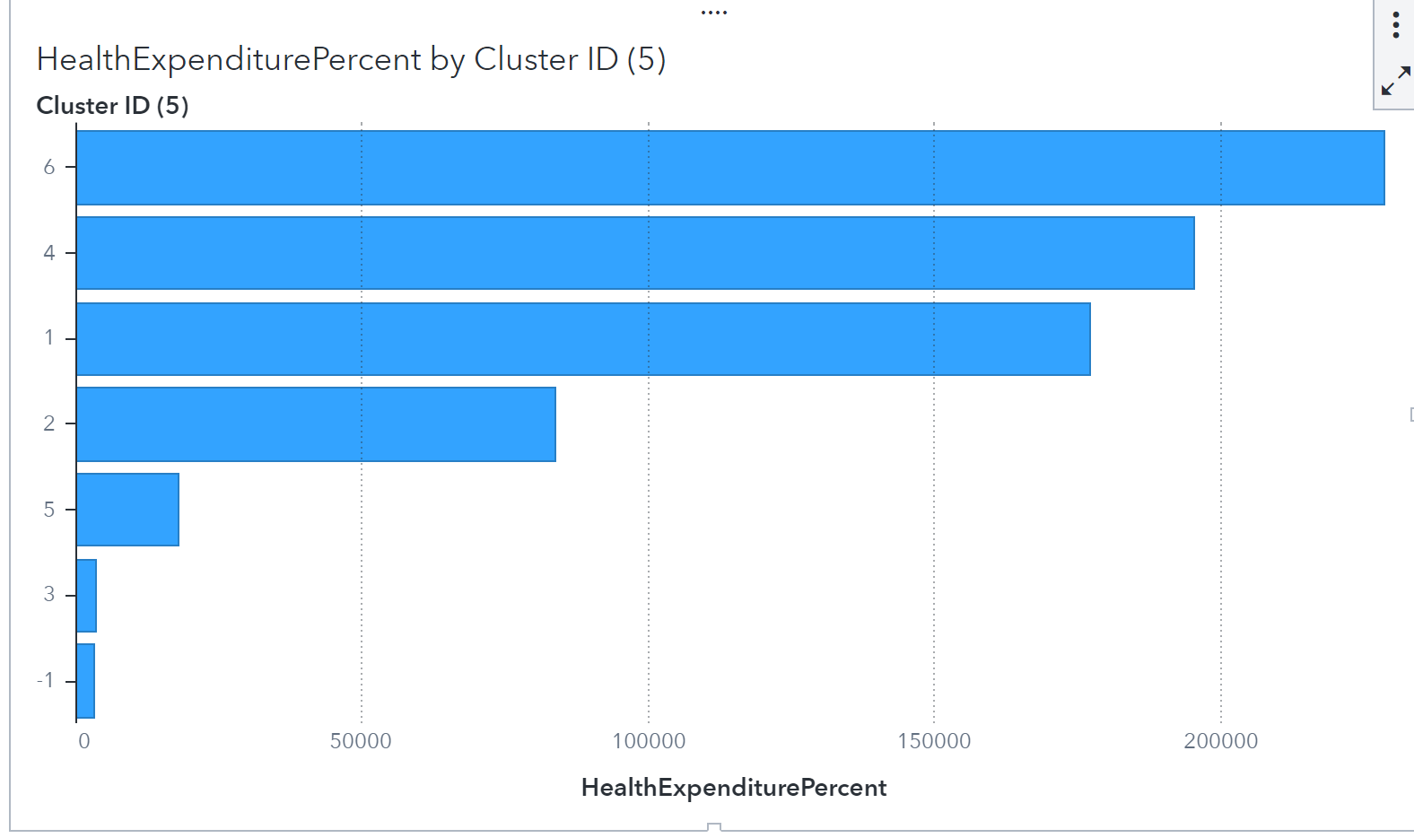
Clustering
Manpower

Slide 50
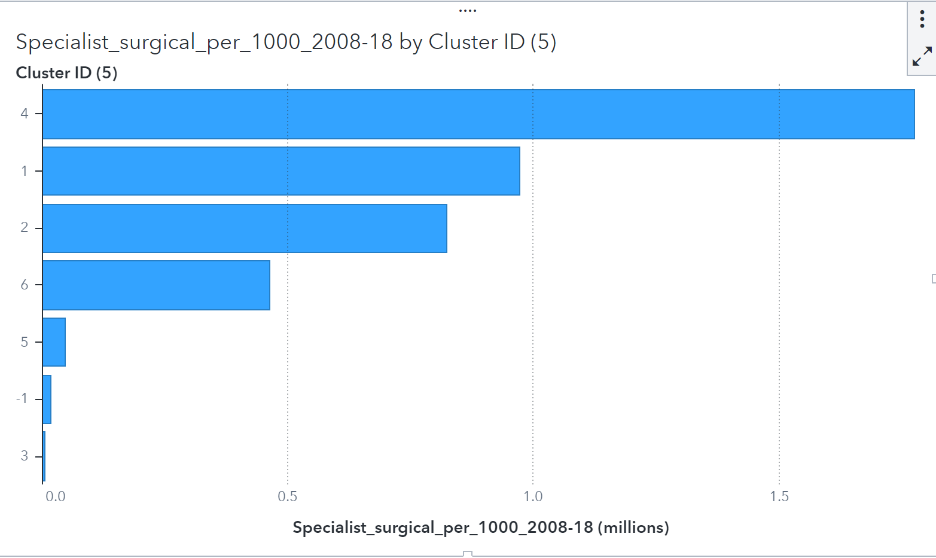
Clustering
Manpower

Slide 51


Decision Tree
Manpower

Slide 52

Decision Tree
Manpower

Slide 53

Decision Tree
Manpower

Slide 54


Decision Tree
Manpower

Slide 55
Recommendations and Analysis
Manpower
Key manpower factors and their effect on the severity of cases:
Healthcare expenditure (% of country’s GDP), healthcare expenditure per capita, nurse & midwives per 1000, tests per million
Healthcare exp per capita also influences the manpower rate heavily
Recommendation: More money spent on healthcare guarantees that we will have more nurses. Although the objective is to have low manpower and a low number of serious cases, there is always another factor influencing how the country is handling the situation.

Slide 56
Prevention

Slide 57
Business Objective - Prevention
Prevention
To determine the factors that can reduce hospitalisation for diseases in Singapore.
Success Criteria: Successfully identify the factors that contributes to such diseases and recommend ways to mitigate them.

Slide 58
Prevention Datasets
Prevention
I have two datasets for prevention. One is used for Data Understanding, and one is used for Data Modeling.
The dataset I used for Data Understanding is the Death Cause Reason by Country Dataset.
The dataset I used for Data Modeling is the Cardiovascular Diseases Dataset.
All datasets are found from kaggle.com
https://www.kaggle.com/datasets/majyhain/death-cause-by-country
https://www.kaggle.com/datasets/sulianova/cardiovascular-disease-dataset

Slide 59

Prevention Datasets -
Death Cause Reason by Country
Prevention
Shows number of deaths by country due to diseases
Dataset was not usable for tableau as columns were the diseases.
Dataset contained 32 columns and contains the death causes by All Genders (Male, Female) and by all age group.

Slide 60

Prevention Datasets -
Death Cause Reason by Country
Prevention
Performed Data Cleaning & Transformation on the dataset
Only selected Singapore dataset and tallied the rest as Total Cases

Slide 61

Data Understanding
Prevention
From the Death Cause Reason by Country dataset, I made some visualisations to rank the prevailing diseases that has caused the most death in Singapore.
Neoplasms are unpredictable in nature as they are forms of cancer.
Cardiovascular Diseases can be predicted. Second most deaths caused in Singapore

Slide 62

Prevention Datasets -
Cardiovascular Diseases
Prevention
Shows 70,000 records of patients with or without Cardiovascular Diseases
Contains 3 types of features:
Objective: factual information;
Examination: results of medical examination;
Subjective: information given by patients;
All dataset values were collected at the moment of medical examination
Indicates if a person has cardiovascular diseases.
1 = True
0 = False

Slide 63

Data Modelling - Preparation
Prevention
The dataset for Cardiovascular Diseases have quite a balanced dataset.
The column ‘cardio’ have around 35000 records for patients with and without Cardiovascular Diseases.
All observations are valid for modeling.

Slide 64

Data Modelling - Feature Selection
Prevention

Slide 65
Data Modelling - Model Overview
Prevention
I have made three different models: Logistic Regression, SVM, and Decision Tree
The Model Comparison done by SAS Viya tells me that the Decision Tree Model is the better model amongst the three.
However, upon inspecting the Model Comparison algorithm, it seems to me that both Logistic Regression and Decision Tree Models are equally effective models as they are relatively close in terms of their validation (KS) Youden.
Since SVM is not a good model as compared to the rest, I will omit the model.

Slide 66




Data Modelling - Models Overview
Prevention
Notes:
SVM is already in highest kernel power: CUBIC.

Slide 67

Data Modelling - Decision Tree (Tuning)
Prevention
Generally remained at default.
Changed Maximum Branches to 3 and Maximum Levels to 8.
Improved the Validation KS(Youden) of the model by 0.002.
Some features with 3 categorical inputs.
Before:
After:

Slide 68

Data Modelling - Decision Tree
Prevention
Identify leaf nodes that has about 70% of its observation = 1 and, more than 100 counts in that node.
Higher the percentage of observations, the more accurate in identifying the factors.
How to identify? Leaf Statistics.

Slide 69

Data Modelling - Decision Tree
Prevention

Slide 70








Data Modelling - Decision Tree
Prevention

Slide 71
Data Modelling - Decision Tree
Prevention
Looking at the split rules, we can determine which features are important.
ap_hi, age(in years), cholesterol seem to be the most significant features
Further supported by Variable Importance

Slide 72

Data Modelling - Decision Tree
Prevention

Slide 73

Data Modelling - Logistic Regression
Prevention

Slide 74

Data Modelling - Comparison
Prevention
14,000 records for validation
Accuracy: 72.93% Precision: 76.32%
Accuracy: 73.93% Precision: 76.47%

Slide 75

Data Modelling - Comparison
Prevention

Slide 76

Data Modelling - Comparison
Prevention

Slide 77
Conclusion & Recommendations
To summarise our findings from Logistic Regression and Decision Tree, the factors that contributes the most in predicting whether a person has Cardiovascular Diseases are: ap_hi, age (in years), and cholesterol.
By mitigating these factors, we can reduce the rates of Cardiovascular Diseases which, ultimately, reduces the hospitalisation rates.
Regular exercises can help maintain patient’s systolic blood pressure (ap_hi) and having a good diet by minimizing fats intake can help reduce cholesterol levels.
In addition, regular checkups as you grow older also helps maintain one’s health.
Spreading awareness can help to mitigate the factors and reduce hospitalisation rates.

Slide 78
Accessibility

Slide 79
Accessibility Objectives
To access the level of inclusivity offered
To access the overall Quality of Life (QOL)
To identify the factors that need improvement for several scopes of accessibility in order to support the patient's’ mental and physical well-being.

Slide 80
Information of Dataset
Accessibility
What does the Dataset means? -> Data related to the quality of life of different cities around the world based on scores of a plethora of categories that includes healthcare and education.
Source of Dataset: Teleport.org
Variables:
Name, Country and Continent of the City.
Housing, Cost of Living, Startups, Venture Capital, Travel Connectivity, Commute, Business Freedom, Safety, Healthcare, Environmental Quality, Economy, Taxation, Internet Access, Leisure & Culture, Tolerance and Outdoors.
Rows of Observation: 267
Is the Data Balanced? Yes

Slide 81

Data Understanding
Accessibility

Slide 82

Data Understanding
Accessibility

Slide 83



Data Understanding
Accessibility

Slide 84



Data Understanding
Accessibility

Slide 85



Data Preparation
Accessibility
Duplicating of columns (x4) to have more than 1000 Data Records
Data Granularity
266 Data Records
1064 Data Records

Slide 86

Correlation Matrix
Accessibility
Correlation Coefficient of Healthcare to other variables is < 0.7
Statistically Significant
Multicollinearity

Slide 87
Modelling Techniques
Accessibility
- Decision Tree
- Linear Regression

Slide 88


Decision Tree
Accessibility
Parameter Tuning
Maximum branches increase from 2 to 3
Maximum levels increase from 6 to 8
Predictor bins increase from 50 to 300

Slide 89
Decision Tree
Accessibility
Before Parameter Tuning
Improvement of Validation ASE by reducing it
After Parameter Tuning

Slide 90

Decision Tree
Accessibility
Variable Importance

Slide 91


Decision Tree
Accessibility

Slide 92

Decision Tree
Accessibility
-> Leaf Node 106, 128 and 71 has the Top 3 highest average healthcare value.

Slide 93


Decision Tree
Accessibility

Slide 94

Decision Tree
Accessibility
Chart
Assessment
Result

Slide 95

Linear Regression
Accessibility
Parameter Tuning
Backward Selection with a Significance level of 0.01 is implemented

Slide 96

Linear Regression
Accessibility
With Parameter Tuning
Shows more variables that are not significant

Slide 97

Linear Regression
Accessibility
Fit Summary
Statistically Significant (Variables)
Variables with p-value < 0.05
72.46 % of Healthcare is explained by the Input Variables

Slide 98

Linear Regression
Accessibility
Parameter Estimates (Categorical Variable)
Direct Relationship between UA_Continent Oceania and Healthcare. (Estimate is +ve)
For every 1 unit of increase in UA_Continent Oceania, Healthcare would have an increase of 4.31 units (Vice Versa)

Slide 99
Linear Regression
Accessibility
Parameter Estimates (Numerical Variable)
Direct Relationship between Business Freedom and Healthcare. (Estimate is +ve)
For every 1 unit of increase in Business Freedom, Healthcare would have an increase of 4.12 units (Vice Versa)

Slide 100

Linear Regression
Accessibility
Residual Plot

Slide 101

Linear Regression
Accessibility
Assessment
Chart
Result

Slide 102
Recommendation
Accessibility
Factors that affect the Accessibility of Healthcare Services to focus on
Business Freedom
Economy
Housing
Notes:
Customer should look at this input for hospital bills and fulfill the business objectives

Slide 103
Conclusion
Accessibility
What can be done to effectively increase the Accessibility of Healthcare?
- More Business Freedom from the country ( Increase of the efficiency of government regulation of business)
- Reduction in Economy of the country ( Decrease of all activity related to the production, consumption, trade and distribution of available goods and services)
- Better Housing in the country (Improvement of the Social and Physical environment where the house is located)
Notes:
Customer should look at this input for hospital bills and fulfill the business objectives

Slide 104
Final Conclusion
“To improve the quality of providing healthcare services”
4 business objectives: Finance, Manpower, Prevention, Accessibility.
Able to recommend and provide solutions that can answer our main problem.

